Slide 1
Developing Yourself and Others as Future Leaders
Ann Page
Lead Clinician – Clinical Services and Workforce Development
Leeds Teaching Hospitals NHS Trust
Immediate Past Chair - United Kingdom Clinical Pharmacy Asssociation

Slide 2
Outline
I do some talking (you interrupt for questions if the spirit moves you!)
You do some talking. (to your colleagues, not to a big group, and with a no role-playing guarantee).
I do a little bit more talking and you ask questions

Slide 3
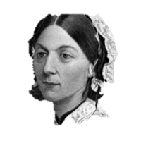
“Let whoever is in charge keep this simple question in her head … how can I provide for the right thing to be always done?”
Florence Nightingale

Slide 4
"I want every little girl
who someone says 'they're bossy'
to be told instead
'you have leadership skills’”
Sheryl Sandberg 2013

Slide 5
"I want every little girl young practitioner
who someone says 'they're bossy'
to be told instead
'you have leadership skills’”
Sheryl Sandberg 2013

Slide 7
What is leadership?
NOT the same as management: non-managers lead.
Care of patient vs. care of population
Own professional group vs. multidisciplinary groups
Wider leadership and influence

Slide 8
Micro to Macro
Sometimes we lead on the care of an individual
Sometimes we lead a team
Team roles may be fluid rather than fixed

Slide 9
Like all skills, leadership can and should be developed.

Slide 10
“organic” development
Use something to undertake a gap analysis - a framework
A useful “scaffolding” on which to hang experiences and aspirations
Prompts reflection
Provides specific criteria against which to self-assess/ask others to describe us

Slide 11
Frameworks available
NHSLA Healthcare Leadership Model
RPS Leadership Development Framework
RPS and APTUK development frameworks

Slide 12
RPS Leadership Development Framework
Based on the NHSLA Healthcare Leadership Model
Same 9 domains of leadership
Enables inter/multidisciplinary communication and development
Tailored to our professional lives and experience (while still being broad enough to be used by all of us)
Accompanied by the handbook:
Maps the domains against the FPF and APF
Lots of useful examples from pharmacy practice

Slide 13
How I use it
For myself and my team….
To map our practice and help plan our development
To help give and receive constructive feedback
In my wider organisation….
To ensure organisational focus on leadership behaviours, e.g. through structured 1:1s or appraisal
To describe desired outcomes of education/development activities
To facilitate succession planning

Slide 14
In my organisation…
Leadership development is a priority for the coming years
600+ staff in a complex system, therefore need leaders in all areas and at all levels
Accessing development and training at all levels is going to be important,
BUT
There’s a lot more to it than going on courses, and the LDF is useful for some in planning development.
Useful to me in prioritising what activities and processes to support

Slide 15
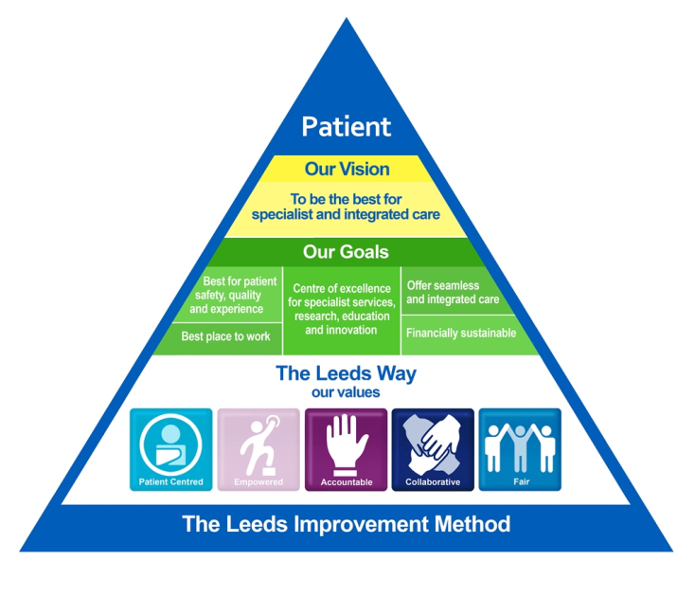
In my organisation…
We have a set of organisational values around which our appraisal is based
We also have a Trust-wide
change management
process

Slide 16
Therefore, use of any development framework has to complement this, not confuse people.

Slide 17
Over to you….
Time for some activity in small groups
I promised no role playing….
I keep my promises!
There will also be no “creeping death” feedback from this activity: your group will get out what you put in.

Slide 18
In a small group of two or three….
Either
Choose a leadership domain you wish to develop. Discuss how your current practice reflects the descriptors and activities you might undertake to develop yourself.
Or
Choose a domain you wish to develop in your team or a team member. How could you support this?
Or
Acknowledge that you chose the wrong session and that this isn’t for you. Use the time for something else constructive. I won’t be offended!

Slide 19
Now…
Join with the small group next to the one you’re in
Learn from their discussions and let them learn from yours

Slide 20
Leadership pro tips….

Slide 21
Leadership pro tips….
Pick your role models
Find your style
Be authentic: be yourself
Lead your values

Slide 22
Get some support!
Build/find your support networks and if necessary, access some leadership development training
Colleagues
UKMI!
UKCPA
RPS
PCPA
GHP
CPPE
NHS leadership programmes
Academic programmes

Slide 23
Don’t be afraid to lead people whose job you can’t do
It’s OK (it’s great!) that it’s no longer all about you
Hard /uncomfortable? That’s how you’ll know you’re developing
Don’t be afraid to be unpopular (sometimes)
Challenge prejudice and bad behaviours - you’ll sleep better…

Slide 24
The world is full of people queuing up to tell you that you can’t do something: they don’t need your help…
Fight imposter syndrome
…but retain some humility!

Slide 25
Forty years is a long time
1840 weeks
9200 days
69,000 hours
It’s up to you how you spend it, but I firmly believe….

Slide 26
You’ll achieve more if you enjoy the people you’re traveling with!

